Slide 1
The United States of America
THE UNITED STATES OF AMERICA
9.83 million km²

Slide 2
GEOGRAPHY GAMES
http://www.sheppardsoftware.com/Geography.htm

Slide 3
American Culture Studies Diversity and the Lay of the Land
America - Population
Population – 329,000,000
Most populous states
California- 39,600,000
Texas – 28,700,000
Florida – 21,312,000
Most populous city – New York city (8,622,000)
Next populous city - Los Angeles (4,000,000)
Notes:
This first number includes the illegal immigrants

Slide 4
Racial/Ethnic Composition estimated 2016
Race / Ethnicity | Number | Percentage of U.S. population
Americans | 329,000,000 | 100.0 %
White or European American | 233,657,078 | 73.3 %
Black or African American | 40,241,818 | 12.6 %
Asian American | 14,674,252 | 4.8 %
American Indian or Alaska Native | 2,932,248 | 0.9 %
Native Hawaiian or other Pacific Islander | 540,013 | 0.2 %
Hispanic or Latino | 54,232,205 | 17.1 %
Notes:
Anyone born to an American in any part of the world is American. Anyone born to immigrants in America is American.

Slide 5
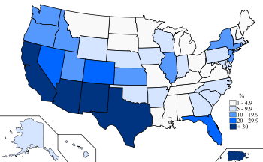
2010 U.S. Census Hispanic population map.
Each of the racial categories includes people who identify their ethnicity as Hispanic or Latino.^{[51]} U.S. federal law defines Hispanic or Latino as "those who classify themselves in one of the specific Hispanic or Latino categories listed on the Census 2000 or ACSquestionnaire - "Mexican", "Puerto Rican", or "Cuban" - as well as those who indicate that they are "other Spanish, Hispanic, or Latino.""^{[52]}
Persons whose ethnicity is identified as Hispanic or Latino may be of any race.
The total population of Hispanic and Latino Americans comprised 50.5 million or 16.3% of the national total in 2010.
Hispanic or Latino categories listed on the Census 2000 or ACSquestionnaire - "Mexican", "Puerto Rican", or "Cuban" - as well as those who indicate that they are "other Spanish, Hispanic, or Latino.""^{[52]}
Persons whose ethnicity is identified as Hispanic or Latino may be of any race.
The total population of Hispanic and Latino Americans comprised 54 million or 17.1% of the national total in 2016.

Slide 6
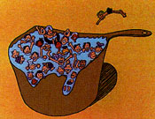
The Melting Pot
Immigrants from every corner of the world blend together and create one
America.
The Salad Bowl
Immigrants from all over the world come to America, blend in yet still retain their own heritage.
Notes:
Salad Bowl – Little Italy, China town, Russian, Polish, etc…

Slide 7
Tiger Woods
Part: African, Tai, European, Native American
Only 1/8 black and yet he is considered black on the census.
As an ideology of immigrant assimilation, the melting pot has persisted as an idealistic vision of the inclusive nature of assimilation in America.

Slide 8
The Great American Melting Pot
The Great American Melting Pot
melting pot

Slide 9
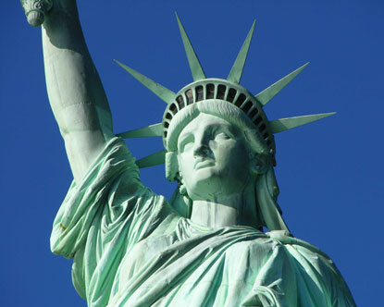
Statue of Liberty
"Give me your tired, your poor / Your huddled masses yearning to breathe free / The wretched refuse of your teeming shore / Send these, the homeless, tempest-tost to me / I lift my lamp beside the golden door!" - Poet Emma Lazarus, "The New Colossus," 1883, inscribed beneath the Statue of Liberty in 1903³⁸

Slide 10
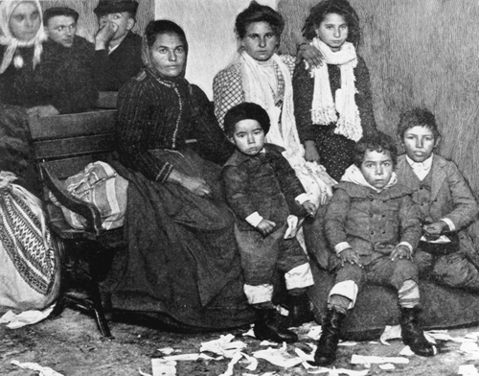
Immigration to Ellis Isand
It has been estimated that one out of every two Americans living today can trace his or her family history back to at least one ancestor who passed through the famous immigration station on New York's Ellis Island.³³
On its busiest day—17 April 1907—the Ellis Island immigration station processed the arrivals of 11,747 European newcomers.³⁴

Slide 11
The Melting Pot/Salad Bowl
The featured song “This Land is Your Land" is one of American all-time favorite folks songs. It's also a patriotic song and has been named as one of the top 10 favorite Fourth of July songs.

Slide 12
American Culture Studies Diversity and the Lay of the Land
Christopher Columbus
Led European expeditions to the Caribbean, Central America and South America. 1492
Catholic Monarchs of Spain sponsored the journey.
Initiated European Colonization of the Americas.
Notes:
This first number includes the illegal immigrants

Slide 13
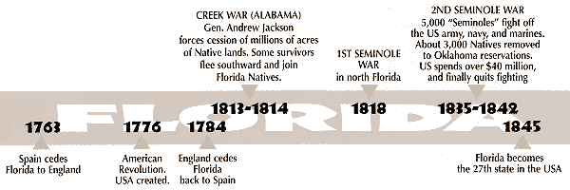
TIMELINE

Slide 14
TIMELINE continued
Today's Seminole Tribe of Florida can be traced back at least 12,000 years, say researchers.
By the time the Spaniards "discovered" Florida (1513), this large territory held, perhaps, 200,000 Seminole ancestors in hundreds of tribes, all members of the Maskókî linguistic family.

Slide 15
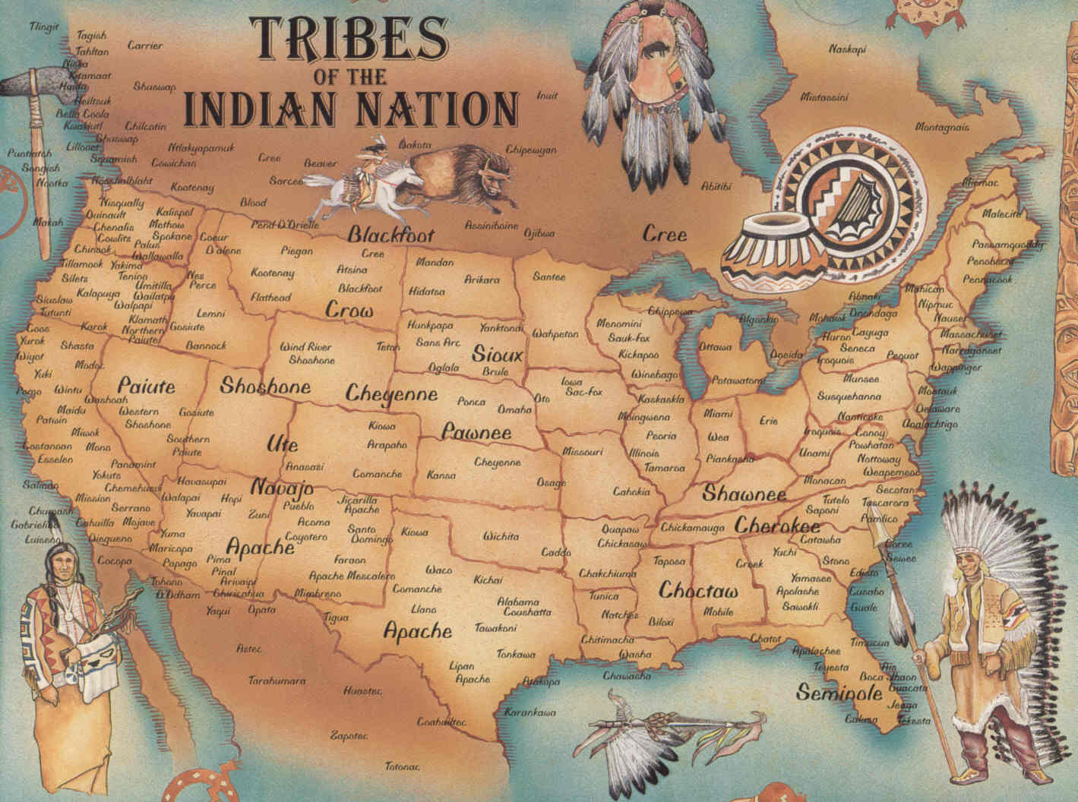
GEOGRAPHY GAMES
NATIVE INDIANS

Slide 16
Indian Resistance and Removal
In the early days of its existence, the fledgling United States government carried out a policy of displacement and extermination against the American Indians in the eastern US, systematically removing them from the path of "white" settlement. Until 1821, Florida remained under the control of the government of Spain.

Slide 17
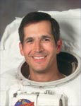
Native Americans
Astronaut, of the Chickasaw Nation.
Herrington is the first Native American to walk in space when launched November 23, 2002 aboard the Space Shuttle Endeavor.
John Herrington
Poet/ Novelist/ Film Producer/ Screenwriter, of the Coeur d'Alene/ Spokane Indian Nations.
Produced the all Native American Film – Smoke Signals
Sherman Alexie
Notes:
Members of his tribe watched the historic launch, and Herrington honored his Native American heritage by carrying six eagle feathers, a braid of sweet grass, two arrowheads, and his nation's flag. Sherman Alexi has written at least 7 books of poetry, and some short stories as well as 2 novels.

Slide 18
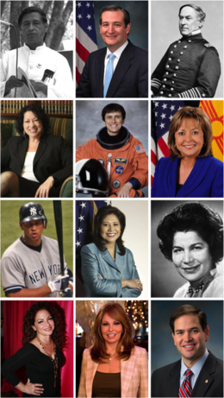
Hispanics
Jimmy Smith
Jose Feliciano
Alberto Gonzalez
Ted Cruz
Sonya Sotomeyer
Marco Rubio
Notes:
Smith – famous actor, Feliciano – musician (singer), Sotomeyer ( Supreme Court judge appointed by Obama), Rubio – republican senator from Fl.

Slide 19
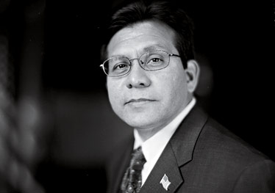
Hispanics in Government
George W Bush’s general council in 1994 in Texas, promoted to Supreme Court in Texas and then became the nation’s first Hispanic Attorney General in 2005
Alberto Gonzales
After the attacks of 9/11, Gonzales helped write the Patriot Act, which expanded federal power in the name of fighting terrorism. He also oversaw the selection of Bush's very conservative judicial nominees.
What is the Patriot Act and what section of it has always been questioned

Slide 20
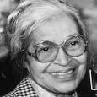
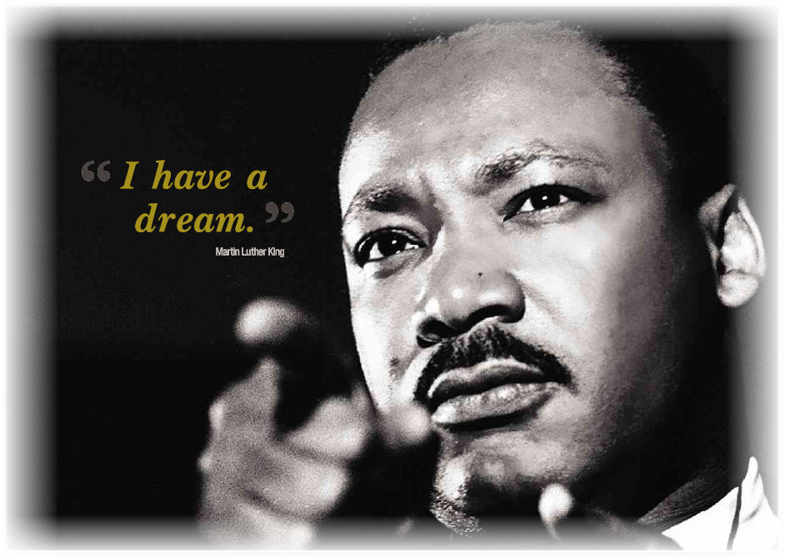
African Americans
Barack Obama
Martin Luther King jr
Rosa Parks
Condoleeza Rice
Colin Powell
Oprah Winfrey
Jacki Robinson
Michael Jordon
Notes:
Obama, the classic American Dream story. From rags to riches. Same for his wife Michele. Citizen of the U.S. – anyone born to an American IS an American.

Slide 21
Slavery
SLAVERY – AFRICAN AMERICANS
White European settlers turned away from indentured servants (mostly poorer Europeans) to a cheaper, more plentiful labor source: African slaves.
1619 a Dutch ship brought 20 Africans ashore at the British colony of Jamestown, Virginia, slavery spread quickly through the colonies.

Slide 22
Civil War and Emancipation
SECESSION OF THE SOUTHERN STATES
THE CIVIL WAR
1861-1865 Tensions between North & South
Confederate States – 11 Southern states secede – President Jefferson Davies
Abe Lincoln (Republican) – President – against slavery in the North.
1863 – Emancipation – Free the slaves (but not all)
Union States rejected slavery, against expansion of slavery to western states.
Notes:
Emancipation is any of various efforts to procuring political rights or equality, Abraham Lincoln consistently made preserving the Union the central goal of the war, though he increasingly saw slavery as a crucial issue and made ending it an additional goal.^{[225]}

Slide 23
Immigration Law of 1924
IMMIGRATION LAW 1924
Quota system intended to keep the composition of the already existing population.
Favored Northern Europeans over Southern Europeans – seen as a racist law in some eyes.
Based on the number of these Europeans in the US at the time:Britains, Germans, Irish and Scandinavians – 87%
Notes:
Think about what was happening in the world in the 1920’s – particularly Europé.

Slide 24
Census
IMMIGRATION LAW 1965
Every 10 years for statistical purposes
Lumping of different groups angers some
Federal Programs
Affirmative Action
Anyone born in the US is automatically a citizen. Anyone born to an American living abroad is also an American citizen.
Cap of 26,000 from any given country within one year
No partiality given to any one country
IMMIGRATION REFORM ACT 1986
Legalize illegals entering before 1982 – penalties to be paid
Illegal to knowingly hire illegal aliens
3 million undocumented illegals were granted legal status
Notes:
Obama and Congress worked on a new immigration bill. Once again, amnesty to illegals (11 million) by a 10 year path to legalization. Strenghthening borders is a sticking point.

Slide 25
IMMIGRATION REFORM
TODAY
California has passed the TRUST Act, which decreases the level of cooperation between state and federal authorities on deporting non-violent lawbreakers. This means that illegal immigrants will no longer have to worry about being deported for traffic violations or other minor infractions.
California has also passed legislation that will grant driver licenses to its illegal-immigrant population.
California already grants in-state tuition and state aid for DREAMers, or illegal immigrants brought to the U.S. as children.

Slide 26
Obama’s Proposals
Strengthen Borders – The number of Border Patrol agents have doubled since 2004. Use of technology to secure land and maritime borders.
Employers Responsibilities – Must verify the workforce is legal by using government databases. Severe penalties for fraud, identity theft etc.
Pathway to legal status – amnesty for those who come clean, pass criminal background checks, submit biometric data, pay fees and penalties.
Earned citizenship for dreamers – Children brought to the US illegally can expedite their citizenship by going to college or joining the armed forces.

Slide 27
Trump’s Proposals
Anti-immigration policies – rescind on the ”DACA” program of Obama. Rescind the ”anchor baby” policy.
Restriction of travellers from certain countries – muslim ban
Deportation of certain groups from – Mexico, El Salvador etc.
Strengthen Borders – ”Build that wall” , severe penalties if caught crossing the borders.

Slide 28
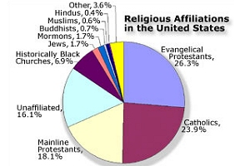
Religion in America

Slide 29
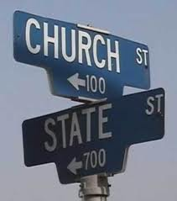
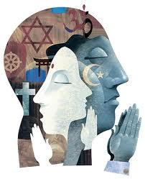
Religion
Since early on, there has always been conflict between the church and the state. What are the conflicts about today?

Slide 30
Teaching Ideas?
Choose a group of Americans and research how / why they came to America. How and where do they live in the country? (Map) What customs and traditions do they bring with them or contribute to their communities? How do the children acclimate to their new environments ie. schools, playgrounds, lunchroom etc. How do they celebrate their own holidays? Are they part of the melting pot or salad bowl?
Research one of the holidays in America – national or religious. How are they celebrated? Who celebrates these holidays?
Famous American Inventors – Ben Franklin, Thomas Edison, Steve Jobs, Bill Gates etc. etc..
Research famous actor/singers/writers etc. What is their family history and how has it effected their work? Compare their lives before and after coming to the U.S.

Slide 31
FAMOUS AFRICAN
AMERICANS

Slide 32
END OF LECTURE 1

Slide 33
Education in America
American Education

Slide 34
The Puritans
The first to bring compulsory education
Universal literacy for men and women
Paid through public taxes
1636 Harvard was the first school and was founded to train ministers
1640 children required to go to school in Massachusetts, paid through property taxes

Slide 35
The Frontier
Promoted democracy, equal opportunities
Western states open to all, thus pressuring eastern states to drop property taxes in order to vote or go to school.
*Take note that on the Frontier, many didn’t feel they needed education because they worked the fields. Ed. often slowed down their work force. Andrew Jackson – 1st President from the Frontier.

Slide 36
Industrial Revolution
Boston – 1st Public High School 1821
Free and for boys only
Science considered very important
The 3 R’s – Readin, Riten, ’Rithmatic
Later on more subjects were added including vocational subjects (practical subjects)

Slide 37
Schools today
10th Ammendment – state and local govt.
Approx. 15,000 local school districts across US
School board – determines curricula, text books, funding, powers for the teacher and community
People usually buy houses based on the school districts. Better school districts usually come with higher property taxes.

Slide 38
Types of Schools
Private – 10% - religious/ethnic, catholic, jewish, muslim, chinese etc . Tuition fees
Boarding schools – exclusive private schools usually for the very wealthy classes
Public schools – funding from the state and local governments.
Home schooling – small numbers

Slide 39
Sequence of Schooling
Kindergatan – 5 years old
Elementary School – grades 1-6
Middle School – 6-8(9)
High School – 10-12
Community college – 2 year college OR
College/University – 4 year college
Masters – 2 years
PHD
Notes:
Note – we learn more than just our specialty. First year is more humanities, then go into our specialties.

Slide 40
Pledge of Allegiance
Elementary schools recite the pledge every morning – saluting the flag
National Anthem is sung
Not obligatory, but most children do it. Immigrants from other countries may object and therefore be waived from this event.
What does the pledge mean?
Notes:
Can also be done in Middle school and High School

Slide 41
Pledge of Allegiance
”One nation under god” – added in 1954
Cold war – a reaction to communism where religion was suppressed
America is not a ”godless” nation

Slide 42
Methodologies
Testing – long ago IQ testing was done
Ranking – students separated by ability – honor classes, remedial classes
Tracking – early age testing done, students then geared toward a specific path ex. college, vocational schools etc.

Slide 43
Extra Curricula Activities
Major part of American Education
School spirit, civic responsibility, democracy
Sports
Music
School newspaper
Drama
Student Government

Slide 44
State of the Nation
1983 – A nation at risk
Wide gaps between ”blacks and whites” and ”rich and poor”
Trying to accommodate all, and in so doing accommplishes little
Disconnect between students and teachers (reality and ideology)

Slide 45
Remedies for troubled public schools
Vouchers
Magnet schools – movie Fame – High School for the arts in NY, Bronx High School of Science where several Nobel prize winners went.
Charter schools – most prevelant public schools. 1991 Minnesota first one. Intended to help minority students with creative curricula – outside the box thinking –teach morals in addition to academics

Slide 46
Federal Involvement
No Child Left Behind Act – 2002 Bush, GW
Teacher accountability
Testing 3-8 and High School – 3 R’s
States design their own tests as each state has different bodies of students
Federal money to successful schools
2014 – all gaps closed b/w races and classes

Slide 47
Disadvantages of NCLB
Unconstitutional – 10th ammendment
Ignores social issues in schools
Demoralizes teachers/stressful
Punish the teachers/staff/administration
AYP – annual yearly progress reports
Teaching to the test
States lower standards to ensure success
Very unpopular with teachers

Slide 48
Race to the Top
Obama’s answer to NCLB
More carrot, less stick
More freedom for the schools, encourages Charter schools
Measures progress rather than just test scores
Merit pay
More popular with the teachers, but still doesn’t always address the social issues

Slide 49
Higher Education
Top 17 of 20 Universities in the world
Ivy League Schools – 8 in the North East, private schools that are very expensive
Havard, Yale, Brown, Cornell, Princeton, University of Pennsylvania, Columbia Dartmouth
Alma Maters for – Obama, Bush, Clinton
Many Nobel Prize winners

Slide 50
Funding
Scholarships
Loans
Work
Parents
Financial Aid
Donations from private citizens – Cosby $1m
Donations from Industry – Gates foundation etc
Donations from government for research

Slide 51
Other sources
GI bill of 1944
Georgia State University – offers complete tuition to those who do well in H.S.
Community Colleges – offer good 2 year programs for very reasonable costs
State schools, cheaper than going out of state

Slide 52
Requirements for University
Application – comes with a fee
Write an essay
Get recommendations from teachers
Grade point average
SAT exams – Scholastic Aptitude Test (Reading, Writing, Vocabulary and Math)
Interview

Slide 53
The American Dream
Education the key to success
Stay in school (Academic or Trade)
Work Hard
Be persistent
Become whatever you want to be
Obama – the ultimate American Dream come true

