Slide 1
Biomedical Engineering - Project Course TBMT14
Marcus Larsson
Göran Salerud
Notes:
Detta är en generell mall för att göra PowerPoint presentationer enligt LiU:s grafiska profil.
Du skriver in din rubrik och eventuell underrubrik i det blå fältet på sid 1. Det blå fältet kan justeras för att
stämma överens med rubrikens längd. Namn och institutionstillhörighet ersätter den svarta texten.
Börja sedan skriva in din text på sid 2.
För att skapa nya sidor, tryck Ctrl+M.
Sidan 3 anger placering av bilder och grafik. Titta gärna på ”Baspresentation 2011” för exempel.
Den sista bilden är en avslutningsbild som visar LiU:s logotype och webbadress.
Om du vill ha fast datum, eller ändra författarnamn, gå in under Visa, Sidhuvud och Sidfot.

Slide 2
Biomedical Engineering - Project Course
TBMT14
LISAM
Project work (U,G) Written assignment (U,G) Entrepreneurship assignment (U, G) | 7,5 hp 1,5 hp 3 hp

Slide 3
Biomedical Engineering - Project Course
Contact persons:
Marcus Larsson (Examiner, Customer group 1, supervisor group 2)
email: marcus.larsson@liu.se
Göran Salerud (Customer group 2, supervisor group 1)
email: goran.salerud@liu.se
Erika Larsson (Educational administrator)
email: erika.larsson@liu.se
phone: 013-286775
Martin Hult (Expert on programing)
martin.o.hultman@liu.se

Slide 4
Biomedical Engineering - Project Course
Schedule at TimeEdit
Meeting room booked every Monday 13:15-17:00:
Project group 1: IMT3 (floor 13)
Project group 2: IMT6 (floor 12)
Electronics and mechanics work shop when needed
Final presentation Dec 17 at 13:15-17:00 in IMT1
General course information can be found in the document Course_Information_TBMT14

Slide 5
Biomedical Engineering - Project Course
Course evaluation – KURT:
År | Svarsfrekvens | Betyg
HT2017-2 | 23% | 4
 | (3 / 13)
HT2016-2 | 31% | 4.25
 | (4 / 13)
HT2015-2 | 16% | 3
 | (3 / 19)
HT2014-2 | 39% | 3.29
 | (7 / 18)
HT2013-2 | 40% | 4.5
 | (4 / 10)
HT2012-2 | 75% | 4.67
 | (3 / 4)
HT2011-2 | 44% | 4
 | (4 / 9)
HT2010-2 | 17% | 5
 | (2 / 12)
HT2009-2 | 100% | 3.83
 | (6 / 6)

Slide 6
Biomedical Engineering - Project Course
Course evaluation – Comments:
“Difficult to building hardware (electronics)”
“Difficult to communicate within the groups”
“Groups internally divided”
”Course teachers fail to notice conflicts within the groups”
“Competition between groups not always appreciated”

Slide 7
Biomedical Engineering - Project Course
Course evaluation – Actions:
Smaller groups (if possible)
Different projects with less focus on hardware
Schedule recurring meetings between project leader and project supervisor
Contact the project supervisor early if issues arises!

Slide 8
Biomedical Engineering - Project Course
Condensed course goal: The goal is that each project group, using the LIPS model, should be able to carry out good engineering and project work to meet customer requirements as outlined by the project description. The total amount of work should, however, not exceed the resources given available by the customer.

Slide 9
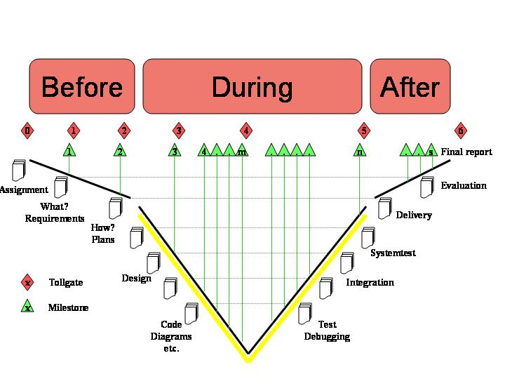
Biomedical Engineering - Project Course
The LIPS model - CDIO
http://www.lips.isy.liu.se/en/

Slide 10
Biomedical Engineering - Project Course
The LIPS model - CDIO
Tollgate - Customer meetings Booked three days in advance
http://www.lips.isy.liu.se/en/

Slide 11
Biomedical Engineering - Project Course
The LIPS model - CDIO
Customer requirements? Book meeting today, if possible!!
http://www.lips.isy.liu.se/en/

Slide 12
Biomedical Engineering - Project Course
The LIPS model - CDIO
Schedule TG meetings with customer
http://www.lips.isy.liu.se/en/

Slide 13
Biomedical Engineering - Project Course
The LIPS model - CDIO
Final presentation Dec 17 at 13:15
http://www.lips.isy.liu.se/en/

Slide 14
Biomedical Engineering - Project Course
The LIPS model - CDIO
Documents according to the LIPS model
http://www.lips.isy.liu.se/en/

Slide 15
Biomedical Engineering - Project Course
Documentation:
Specification of requirements (TG2)
Project plan including an system overview and activity list (Sup.)
Time plan (Sup.)
Specification of design (TG3)
General test plan (TG4)
User manual (TG5)

Slide 16
Biomedical Engineering - Project Course
Documentation:
Protocol for the acceptance test (TG5)
Final report with a reflection document (TG6)
Status reports (Weekly sent to Sup.)
Reports over used time and resources (Weekly sent to Sup.)
Protocols from group meetings
Theoretical assignment (individually written; max 1500 words).

Slide 17
Biomedical Engineering - Project Course
Project plan and Time plan:
Internal document
Identify activities of manageable size
Time plan - Don’t forget to take the examination period into account!
Reviewed by supervisor
Submit to supervisor 24 Sep
Revised version should be submitted 8 Oct

Slide 18
Biomedical Engineering - Project Course
Weekly reports to your supervisor:
Status reports (Monday 17:00; Finished, ongoing and planed activities)
Reports over used time and resources (Monday 17:00; Use LIPS template)
Protocols from weekly group meetings included as appendix in final report, together with all other documents (plans and reports).

Slide 19
Biomedical Engineering - Project Course
Theoretical assignment:
40 hours per person
Schedule meetings / lectures with supervisor.
Individually written – Max 1500 words.
Submitted to your supervisor no later than three weeks before the final presentation (26 Nov).

Slide 20
Biomedical Engineering - Project Course
Resources:
200 hours per person (not including the individual assignment)
Expert time – 1 hour per week
Supervisor meetings

Slide 21
Biomedical Engineering - Project Course
Group functions/responsibilities beside project leader:
Documentation
Design
Implementation
Testing
Hardware
Software
Customer contact
Quality
…

Slide 22
Biomedical Engineering - Project Course
Final words:
Quality of documents is important!
LIPS example/templates documents at: www.lips.isy.liu.se/en/
Start right away:
Study the LIPS model
Group contract
Responsibilities in your group (Project leader, …)
Requirement specification, Project plan and time plan
Book theoretical seminars with supervisor.

